Slide 1


<Name>
<Date>

Slide 2

Outline
Executive Summary
Introduction
Methodology
Results
Conclusion
Appendix

Slide 3
Executive Summary
Summary of methodologies
Summary of all results

Slide 4
Introduction
SpaceX showcases its Falcon 9 rocket launches on its official website, pricing them at 62 million dollars, whereas other providers charge upwards of 165 million dollars for each launch. The substantial cost savings attributed to SpaceX result from the reusability of the first stage. If a competitor is able to determine the success rate of Falcon 9 landings, they can effectively estimate the cost of the launch, which would allow them to bid more competitively.
Key problem: Determine whether the first stage of the Falcon 9 rocket will land to forecast the cost of the launch.

Slide 5

Section 1

Slide 6
Methodology
Executive Summary
Data collection methodology:
Launch data was collected through a combination of accessing the SpaceX API and webscraping Falcon 9 and Falcon Heavy Launches Records from Wikipedia.
Perform data wrangling
The number of launches for each site was calculated.
The number and occurrence of each orbit was calculated.
The number and occurences of mission outcomes for each orbit was calculated.
A landing outcome label was created from the Outcome column.

Slide 7
Methodology
Executive Summary
Perform exploratory data analysis (EDA) using visualization and SQL
Perform interactive visual analytics using Folium and Plotly Dash
Perform predictive analysis using classification models
The feature matrix and target array were created and the data standardized.
The data was split using the train_test_split library into training and testing data sets.
4 different models were trained using the training dataset, and the best hyperparameters found through performing GridSearchCV.
The accuracy of the models was then determined using the testing data and the score method.

Slide 8
Data Collection
Datasets for the analysis were collected by two different methods, namely:
Data Collection
SpaceX API
Webscraping

Slide 9
Data Collection – SpaceX API
The full API notebook can be found at the following Github URL:
https://github.com/Boeloev21/Applied-Data-Science-Capstone/blob/main/jupyter-labs-spacex-data-collection-api.ipynb
Define API call functions, i.e: def getBoosterVersion(data):
for x in data['rocket']:
if x:
response = requests.get("https://api.spacexdata.com/v4/rockets/"+str(x)).json()
BoosterVersion.append(response['name'])
Connect to API and parse data into a dataframe: static_json_url='https://cf-courses-data.s3.us.cloud-object-storage.appdomain.cloud/IBM-DS0321EN-SkillsNetwork/datasets/API_call_spacex_api.json’
response.status_code
raw_data = response.json()
data = pd.json_normalize(raw_data)
Make calls to the API to obtain data: getBoosterVersion(data)

Slide 10
Data Collection - Scraping
The full API notebook can be found at the following Github URL:
https://github.com/Boeloev21/Applied-Data-Science-Capstone/blob/main/jupyter-labs-webscraping.ipynb
HTML Request
Request Falcon 9 launch data as an HTML page
response = requests.get(static_url)
Create a Beautiful Soup Object
soup = BeautifulSoup(launch_data, 'html.parser')
html_tables = soup.find_all('table')
Parse HTML Tables into a Dataframe
launch_dict= dict.fromkeys(column_names)
df= pd.DataFrame({ key:pd.Series(value) for key, value in launch_dict.items() })
launch_data = response.text
first_launch_table = html_tables[2]

Slide 11
Data Wrangling
Calculate the number of launches on each site
number_of_launches = df['LaunchSite'].value_counts()
Calculate the number and occurrence of each orbit
number_of_orbits = df['Orbit'].value_counts()
Calculate the number and occurence of mission outcome of the orbits
landing_outcomes = df['Outcome'].value_counts()
for i,outcome in enumerate(landing_outcomes.keys()):
number_of_launches
number_of_orbits
landing_outcomes
print(i,outcome)
bad_outcomes=set(landing_outcomes.keys()[[1,3,5,6,7]])
bad_outcomes
The full notebook can be found at the following Github URL:
https://github.com/Boeloev21/Applied-Data-Science-Capstone/blob/main/labs-jupyter-spacex-Data%20wrangling.ipynb

Slide 12
EDA with Data Visualization
Scatter point charts were used to visualize the relationship between different features with numerical values, i.e. like the payload mass versus the launch site.
Barcharts were used to visualize the relationship between different categorical features, i.e. like the success rate for each orbit.
Line charts were used to visualize the change in the values of features, i.e. like the yearly success rate of Falcon 9 launches.
The full notebook can be found at the following Github URL: https://github.com/Boeloev21/Applied-Data-Science-Capstone/blob/main/jupyter-labs-eda-dataviz.ipynb.jupyterlite.ipynb

Slide 13
EDA with SQL
Display the names of the unique launch sites in the space mission: %sql SELECT DISTINCT "Launch_Site" FROM SPACEXTABLE;
Display 5 records where launch sites begin with the string 'CCA’: %sql SELECT * FROM SPACEXTABLE WHERE "Launch_Site" LIKE 'CCA%' LIMIT 5;
Display the total payload mass carried by boosters launched by NASA (CRS): %sql SELECT SUM("PAYLOAD_MASS__KG_") AS "Total Payload Mass (kg)" FROM SPACEXTABLE WHERE "Customer" = "NASA (CRS)";
Display average payload mass carried by booster version F9 v1.1: %sql SELECT AVG("PAYLOAD_MASS__KG_") AS "Average Payload Mass" FROM SPACEXTABLE WHERE "Booster_Version" = 'F9 v1.1’;
List the date when the first succesful landing outcome in ground pad was acheived.: %sql SELECT MIN(Date) AS FirstSuccess FROM SPACEXTABLE WHERE "Landing_Outcome" = 'Success (ground pad)’;

Slide 14
EDA with SQL
List the names of the boosters which have success in drone ship and have payload mass greater than 4000 but less than 6000: %sql SELECT "Booster_Version" FROM SPACEXTABLE WHERE "Landing_Outcome" = 'Success (drone ship)' AND "PAYLOAD_MASS__KG_" > 4000 AND "PAYLOAD_MASS__KG_" < 6000;
List the total number of successful and failure mission outcomes: %sql SELECT "Mission_Outcome", COUNT(*) AS TotalCount FROM SPACEXTABLE WHERE "Mission_Outcome" IN ('Success','Failure') GROUP BY "Mission_Outcome";
List the names of the booster_versions which have carried the maximum payload mass: %sql SELECT "Booster_Version" FROM SPACEXTABLE WHERE "PAYLOAD_MASS__KG_" = (SELECT MAX("PAYLOAD_MASS__KG_") FROM SPACEXTABLE);
List the records which will display the month names, failure landing_outcomes in drone ship ,booster versions, launch_site for the months in year 2015: %sql SELECT substr(Date, 6, 2) AS Month, "Booster_Version", "Launch_Site", "Landing_Outcome" FROM SPACEXTABLE WHERE substr(Date, 0, 5) = '2015' AND "Landing_Outcome" = 'Failure (drone ship)’;
Rank the count of landing outcomes (such as Failure (drone ship) or Success (ground pad)) between the date 2010-06-04 and 2017-03-20, in descending order: %%sql SELECT "Landing_Outcome", COUNT(*) AS OutcomeCount FROM SPACEXTABLE WHERE Date BETWEEN '2010-06-04' AND '2017-03-20’ GROUP BY "Landing_Outcome“ ORDER BY OutcomeCount DESC;
Full notebook Github URL: https://github.com/Boeloev21/Applied-Data-Science-Capstone/blob/main/jupyter-labs-eda-sql-coursera_sqllite.ipynb

Slide 15
Build an Interactive Map with Folium
Marker, Circle, and popup for NASA Johnson Space Centre
Marker, circle, and popup for each launch site
Marker cluster indicating the successful and failed launches for each site.
Polylines to the nearest coast, city, railways, and highways were added to see which factors make up the ideal location of a launch site.
The full notebook can be found at the following Github URL: https://github.com/Boeloev21/Applied-Data-Science-Capstone/blob/main/lab_jupyter_launch_site_location.jupyterlite.ipynb

Slide 16
Build a Dashboard with Plotly Dash
A pie chart was added to interactively visualize the ratios of successful to failed launches for each launch site.
A scatterplot was added to interactively visualize how the payload mass effect the launch outcome for different booster types.
The full python file for the dashboard can be found at the following Github URL: https://github.com/Boeloev21/Applied-Data-Science-Capstone/blob/main/spacex_dash_app.py

Slide 17
Predictive Analysis (Classification)
Four machine learning models were built and trained on the available launch data (logistic regression, support vector machine, decision tree classifier, k nearest-neighbours)
The full notebook can be found at the following Github URL: https://github.com/Boeloev21/Applied-Data-Science-Capstone/blob/main/SpaceX_Machine_Learning_Prediction_Part_5.jupyterlite.ipynb
Set up the feature matrix (X) and target array (y)
Split the data into a training set and testing set using the Test_train_split method
Initialize the selected model and perform a GridsearchCV using the training set to determine the best hyperparameters.
Evaluate the accuracy of the the model on the test data using the Score method

Slide 18
EDA Results
SLC-4E had the highest success rate of all launch sites at 77%
The number of successful launches increased as the amount of flights increased.
Total launches decreased above a payload mass of 10 000kg with only two launch sites having launches above this value.
The greatest success rates were found in orbits ES-L1, GEO, HEO, and SSO, all having a 100% success rate.
The success rate of flights in the LEO orbit increases along with the flight number, whereas in other orbits the correlation seems less defined.
Launches in VLEO orbit consist solely of payloads larger than 12 000kg
The success rate of launches increases yearly reaching its peak in 2019.

Slide 19
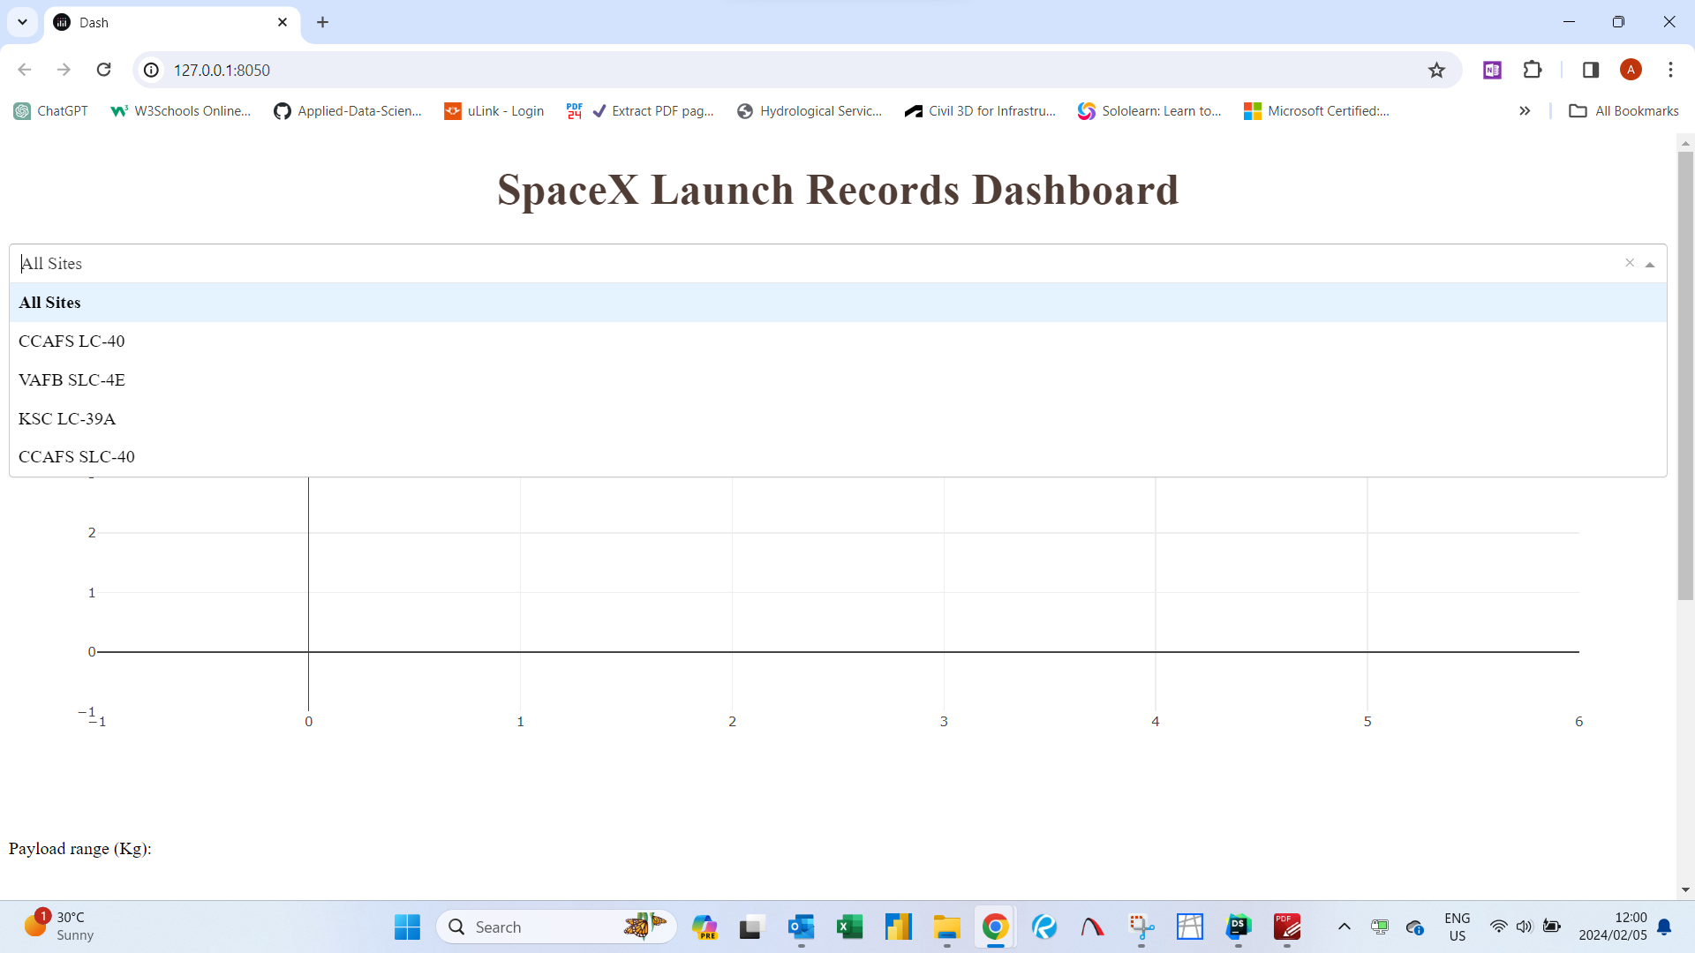
Interactive Analytics Demo

Slide 20
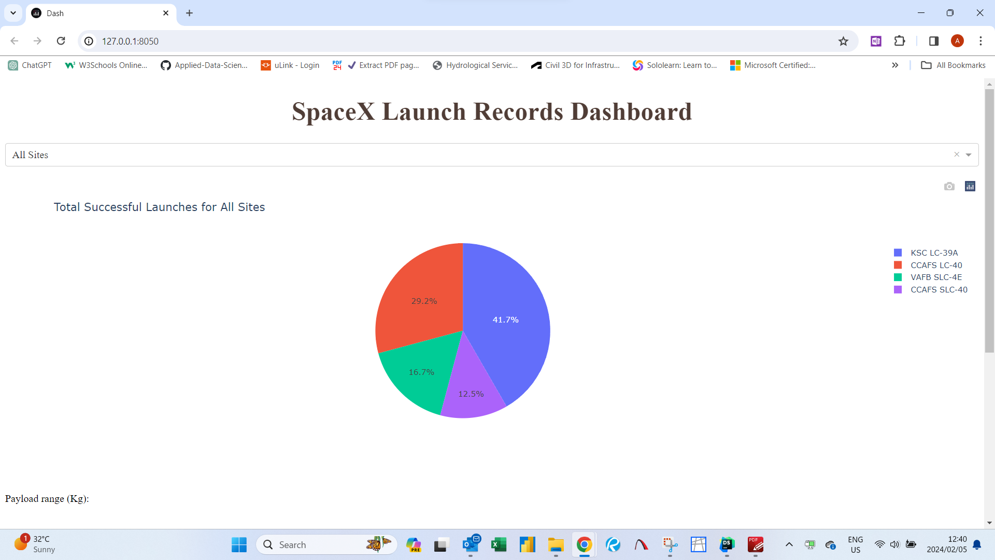
Interactive Analytics Demo

Slide 21
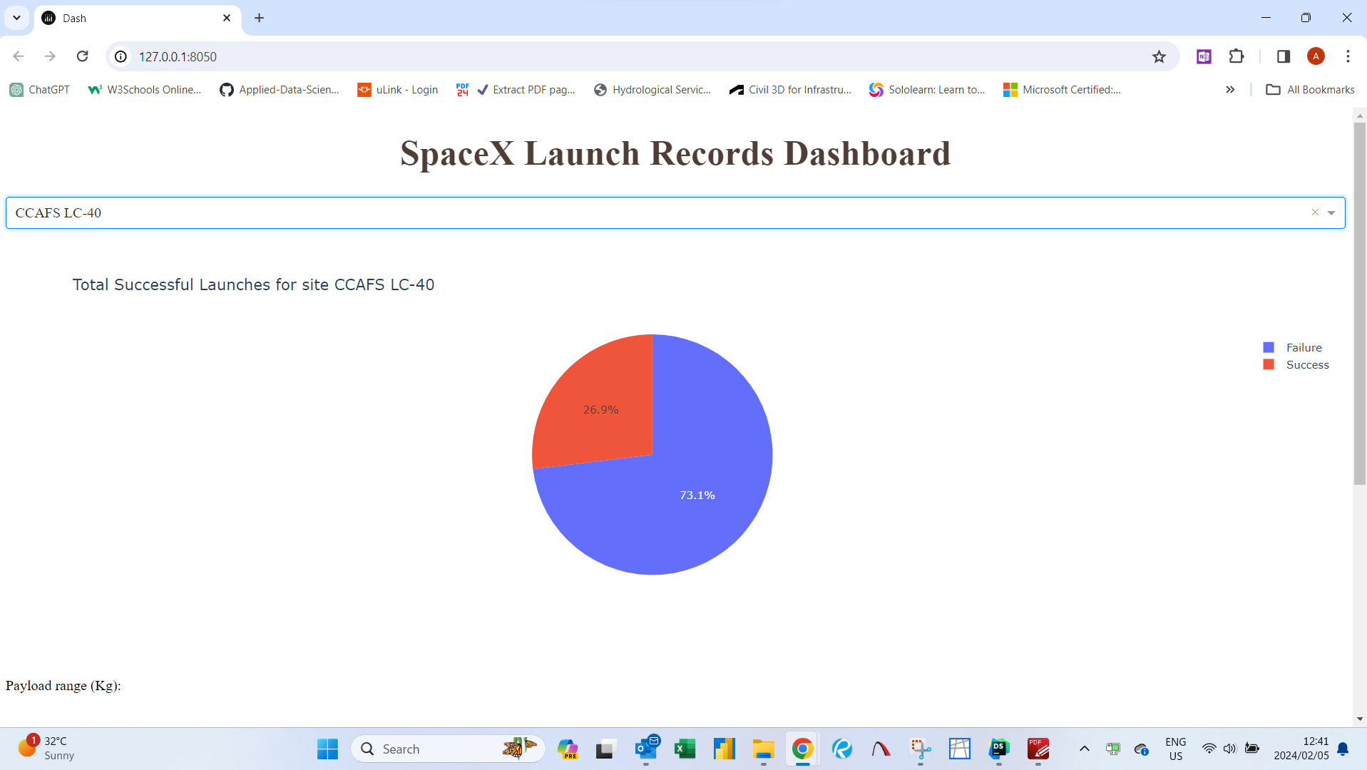
Interactive Analytics Demo

Slide 22
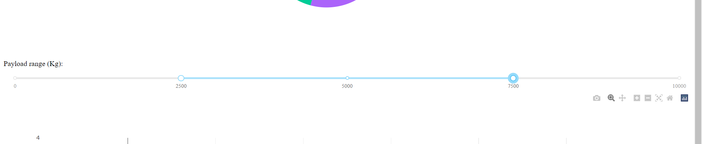
Interactive Analytics Demo

Slide 23
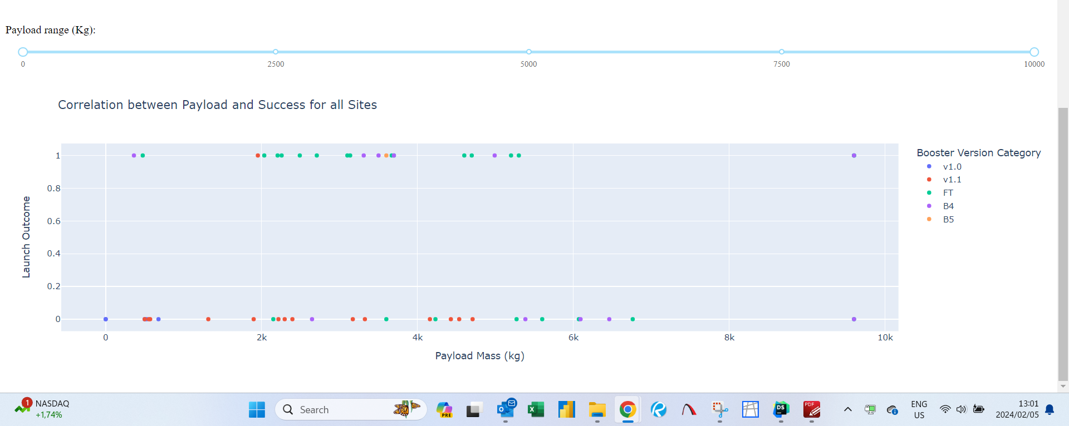
Interactive Analytics Demo

Slide 24
Predictive Analysis Results
The logistic regression model had best parameters of: 'C': 0.1, 'penalty': 'l2', 'solver': 'lbfgs’ and an accuracy score of 0.8333333333333334
The Support Vector Machine model had best parameters of: 'C': 0.049770235643321115, 'gamma': 0.01873817422860384, 'kernel': 'linear’ and an accuracy score of 0.8333333333333334
The decision tree classifier model had best parameters of: 'criterion': 'entropy', 'max_depth': 2, 'max_features': 'sqrt', 'min_samples_leaf': 1, 'min_samples_split': 5, 'splitter': 'best’ resulting in an accuracy score of 0.9444444444444444
The k-nearest neighbours model had best parameters of: 'algorithm': 'auto', 'n_neighbors': 1, 'p’: 1 resulting in an accuracy score of 0.5555555555555556
Comparing the precision of all 4 models indicates that the decision tree classifier is best suited to predict the success of the launches with a precision of 0.9230769230769231

Slide 25

Section 2

Slide 26
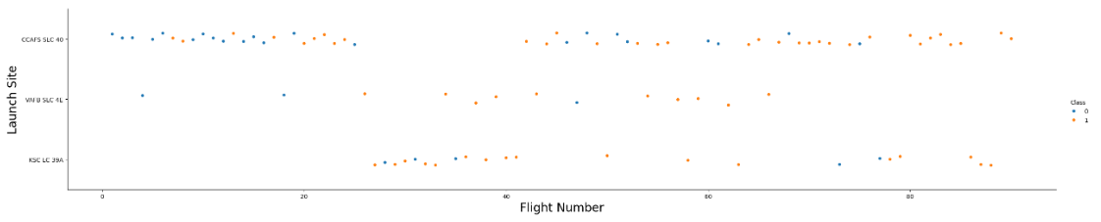
Flight Number vs. Launch Site
For all launch sites the success rate of launches increases with the increase in the number of flights launched from the sites.

Slide 27
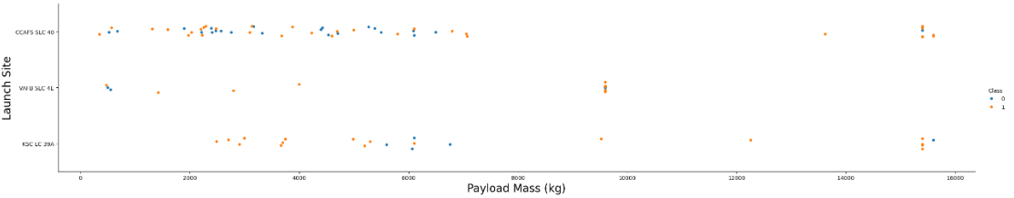
Payload vs. Launch Site
At CCAFS SLC-40 and KSC LC-39A the majority of the launches were at payloads below 8000kg
Payloads above 10 000kg were fewer but have higher success rates.

Slide 28
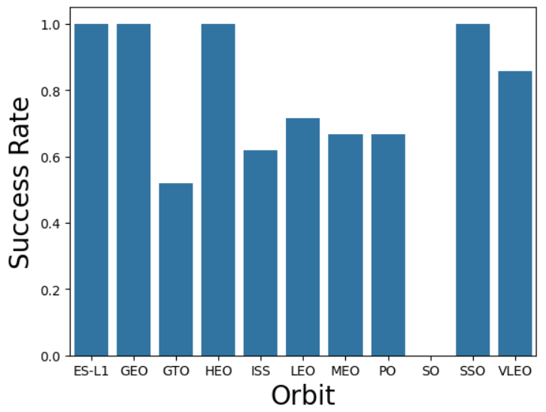
Success Rate vs. Orbit Type
The highest success rates were found in the ES-L1, GEO, HEO and SSO orbits.
The SO orbit had the lowest success rate at 0

Slide 29
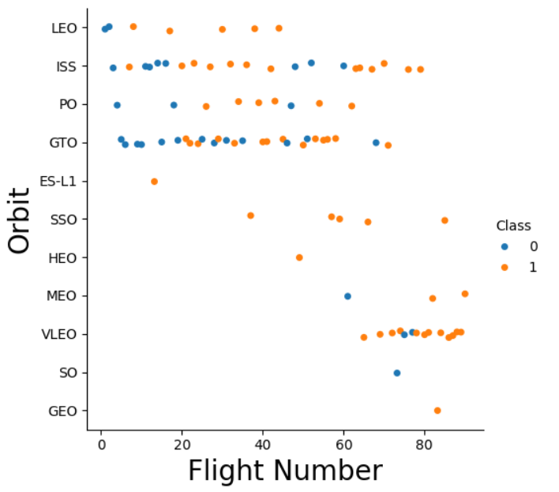
Flight Number vs. Orbit Type
In the LEO, ISS and PO orbits the success rate of the launches showed a correlation with the number of flights.
Success of the launches in the GTO orbit appear to be unrelated to the number of launches in this orbit.

Slide 30
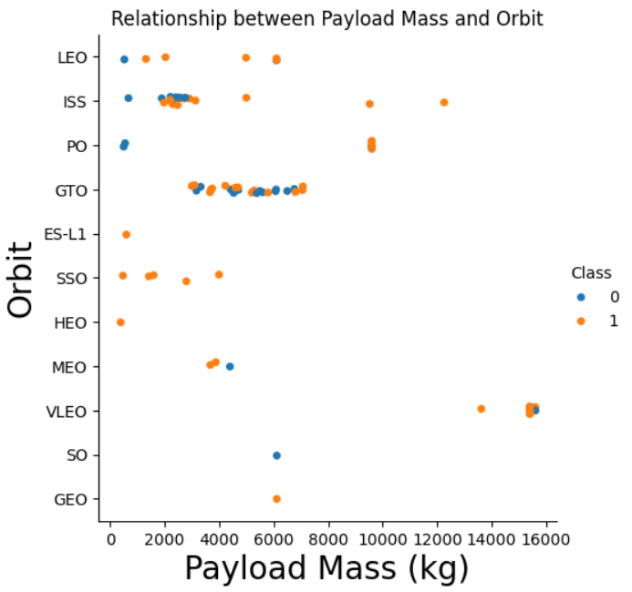
Payload vs. Orbit Type
Most launches were at payload masses below 10 000kg
Heavier payload launches (above 10 000kg) are only found in the ISS, PO and VLEO orbits
Higher payload launches tend to have a higher success rate.

Slide 31
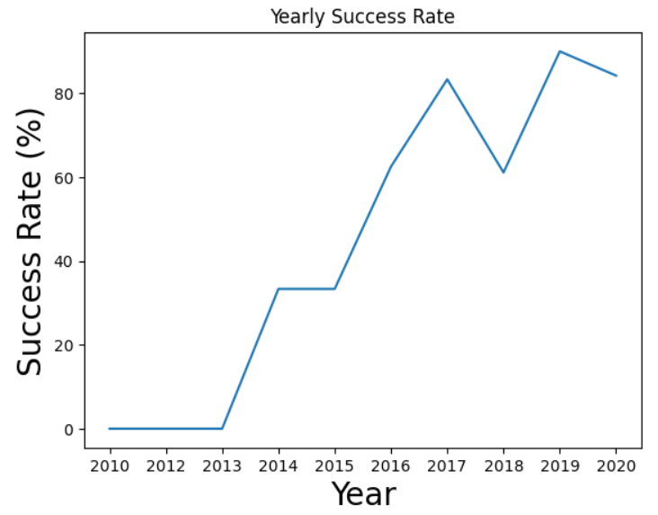
Launch Success Yearly Trend
The success rate of the launches show an upward trend from the initiation in 2013, reaching a peak in 2019.

Slide 32
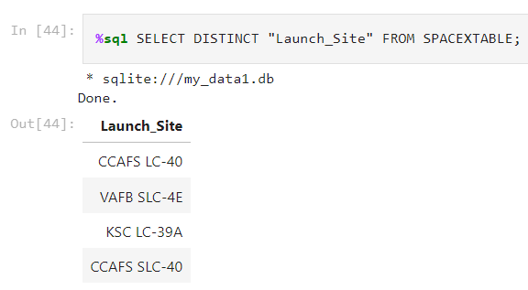
All Launch Site Names
There are four unique launch sites in the SpaceX database

Slide 33
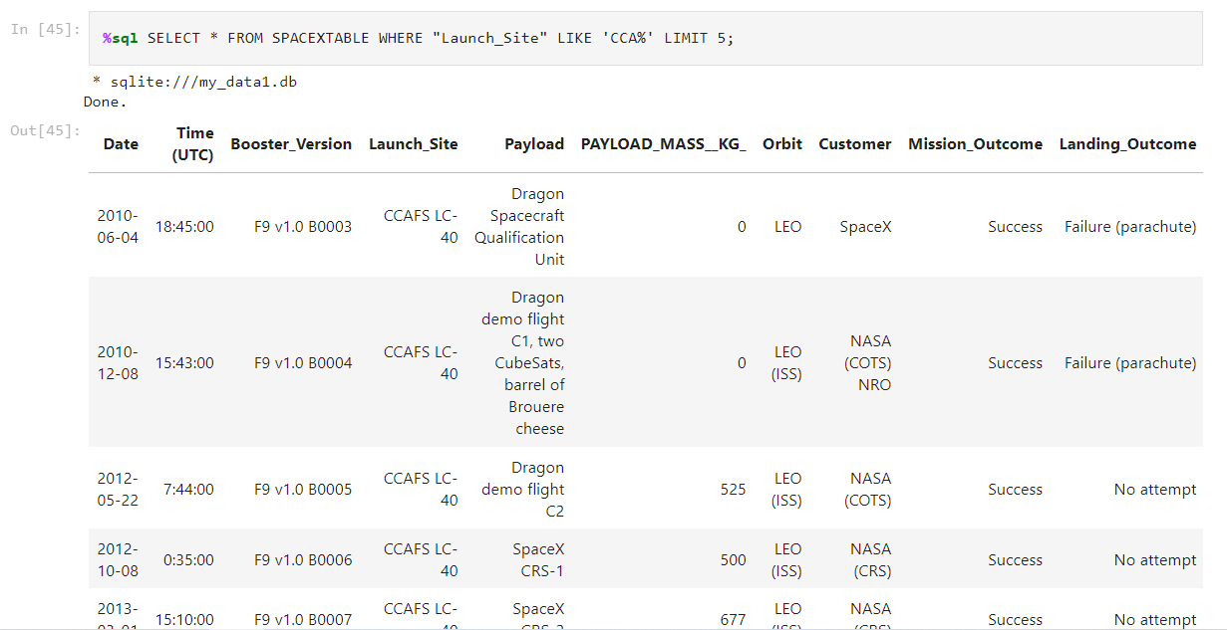
Launch Site Names Begin with 'CCA'
%sql SELECT * FROM SPACEXTABLE WHERE "Launch_Site" LIKE 'CCA%' LIMIT 5;
Using the query, we are able to filter results of launches from CCAFS LC-40

Slide 34
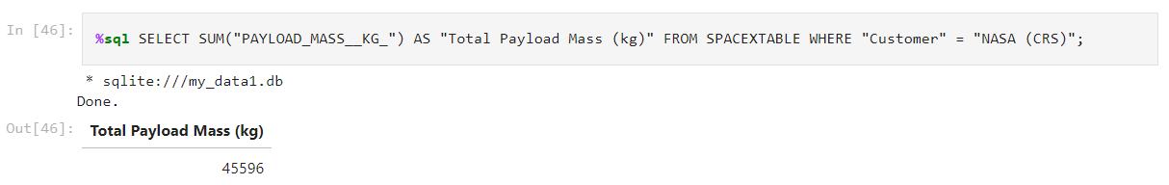
Total Payload Mass
The total payload of all SpaceX launches was calculated to be 45596kg

Slide 35
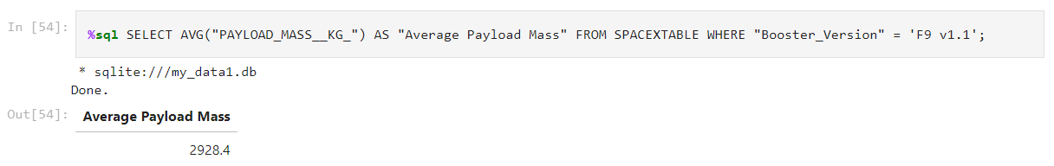
Average Payload Mass by F9 v1.1
The average payload mass carried by booster version F9 v1.1 was calculated to be 2928,4kg

Slide 36
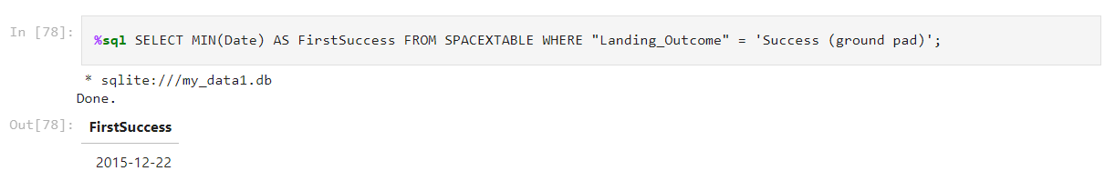
Filtering the Date column for the the minimum value where the landing outcome is “Success (ground pad)” we find that the first successful landing was on 2015-12-22.
First Successful Ground Landing Date

Slide 37
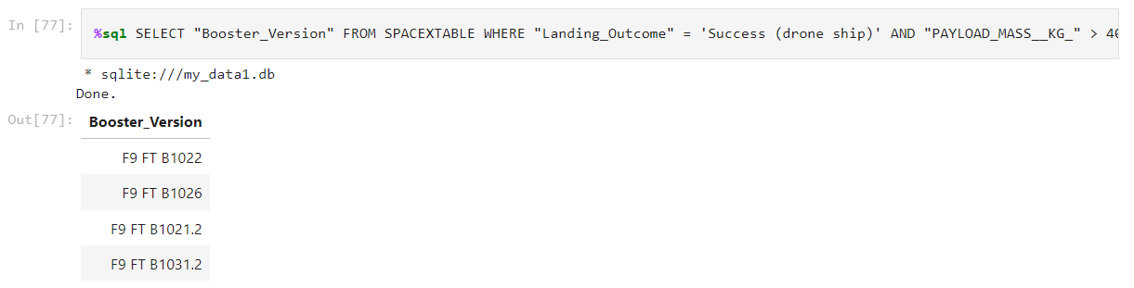
Successful Drone Ship Landing with Payload between 4000 and 6000
Filtering the Booster version column for values where the Landing outcome is “Success (drone ship)” and PAYLOAD_MASS_KG_ is between 4000 and 6000kg we obtain 4 booster versions.

Slide 38
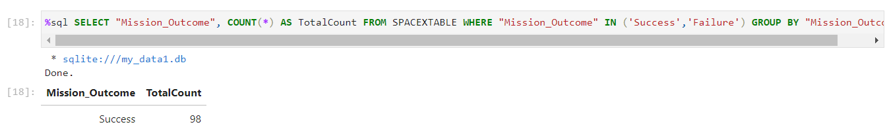
Total Number of Successful and Failure Mission Outcomes
The total number of successful missions is 98

Slide 39
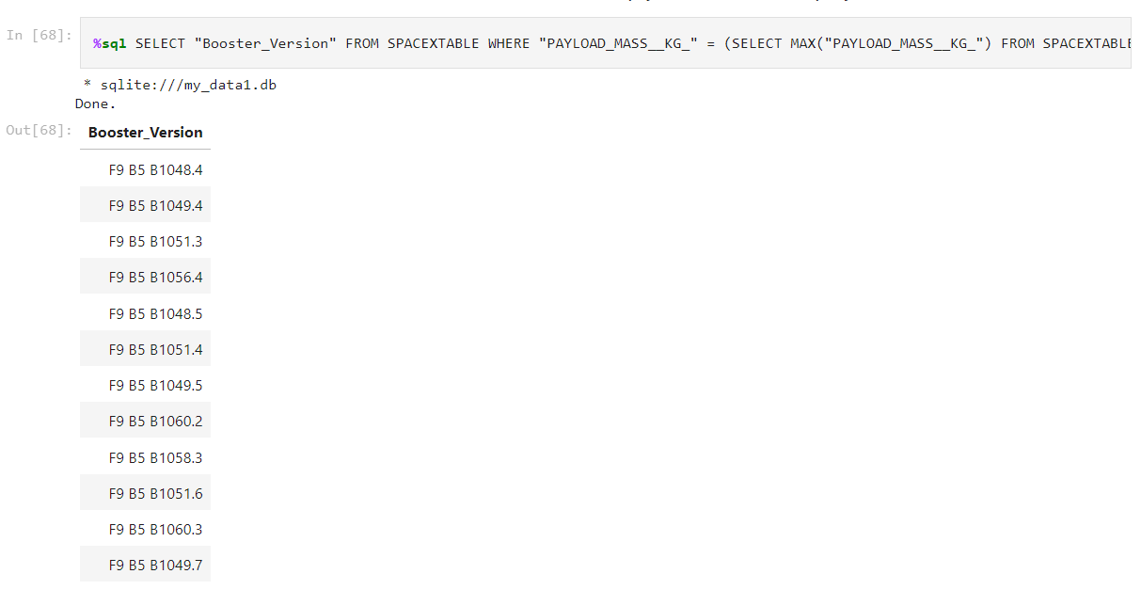
Boosters Carried Maximum Payload
Using a subquery, we can find a list of the booster versions that carried the maximum payload

Slide 40
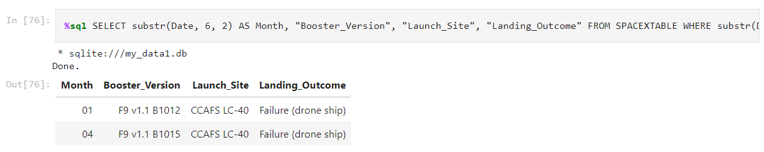
2015 Launch Records
In 2015 two failed launches occurred in the months of January and April

Slide 41
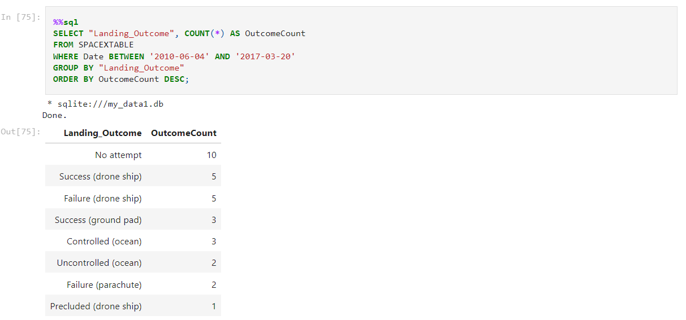
The highest count was for launches where no attempt was made to land the second stage.
Drone ship landings showed and equal split between the amount of successful landings and failed landings
Rank Landing Outcomes Between 2010-06-04 and 2017-03-20

Slide 42

Section 3

Slide 43
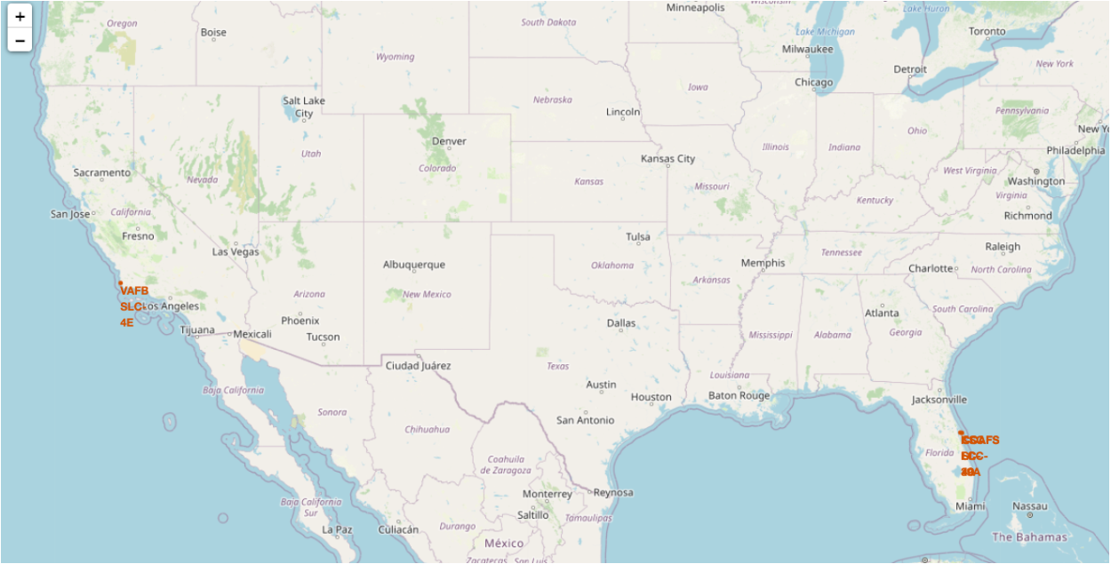
Launch Site Locations
Launch sites are located close to coastal areas to allow launches to be done over the ocean

Slide 44
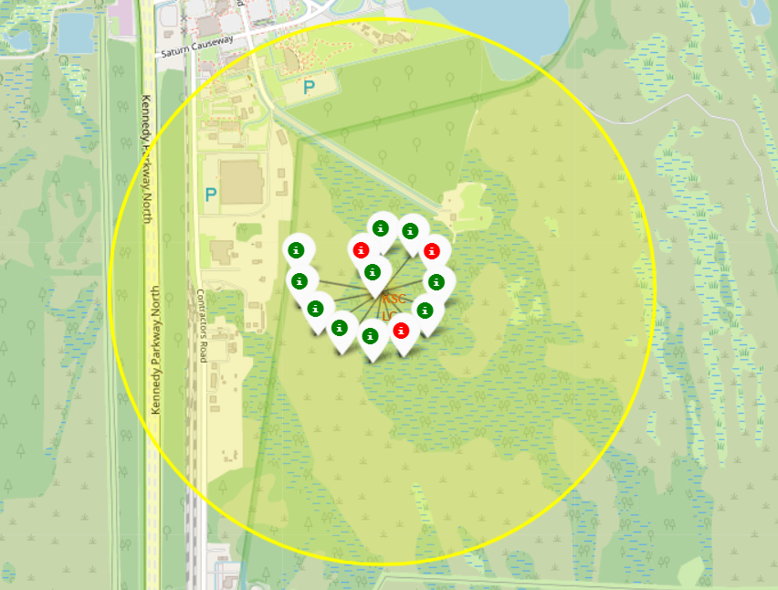
Marker Cluster for Successful/Failed Launches
A marker cluster was created to indicate all successful (Green icon) and failed (red icon) launches for each launch site.

Slide 45
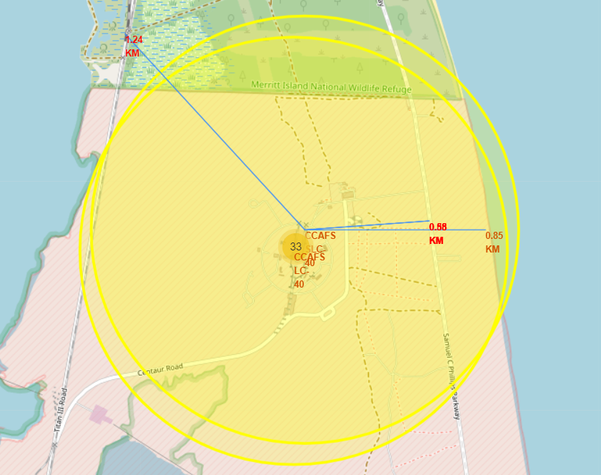
Launch Site Proximity
Launch sites tend to be located near coastlines, railroads, and highways which facilitates the successful delivery of materials and the safety of the launch procedure.

Slide 46

Section 4

Slide 47
Launch Success Count For All Sites
The greatest distribution of successful launches were from KSC LC-39A with a launch success rate of 41,7%

Slide 48
Correlation Between Payload Success for All Sites
The greatest amount off successful launches occurred at payloads of less than 6000kg

Slide 49

Section 5

Slide 50
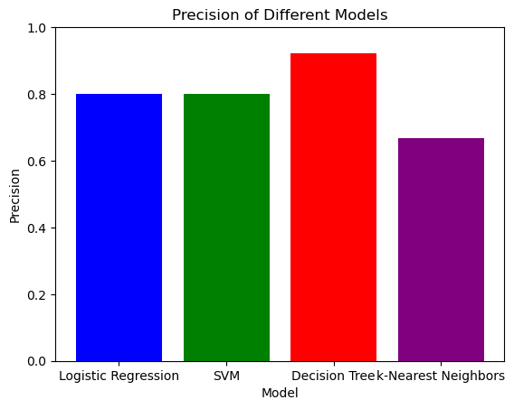
Logreg Precision: 0.8 SVM Precision: 0.8 Decision Tree Precision: 0.9230769230769231 k-Nearest Neighbors Precision: 0.6666666666666666
Classification Accuracy
The Decision tree model had the greatest precision when tested using the test data.
Logreg Precision: 0.8
SVM Precision: 0.8
Decision Tree Precision: 0.9230769230769231
k-Nearest Neighbors Precision: 0.6666666666666666

Slide 51
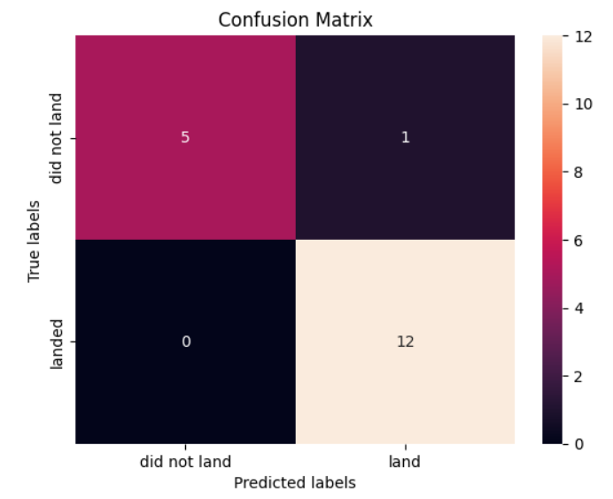
Confusion Matrix
The confusion matrix for the decision tree classifier indicates that we only found 1 false positive and no false negatives when the test data was used.

Slide 52

Conclusions
A decision tree classifier model can successfully be used to predict the success rate of SpaceX launches, given data such as the payload mass and orbit.
Lower payload masses tend to have a higher success rate
The number of successful launches tends to increase as the number of flights increases

Slide 53
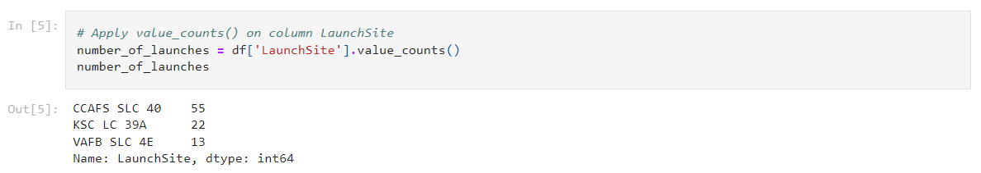
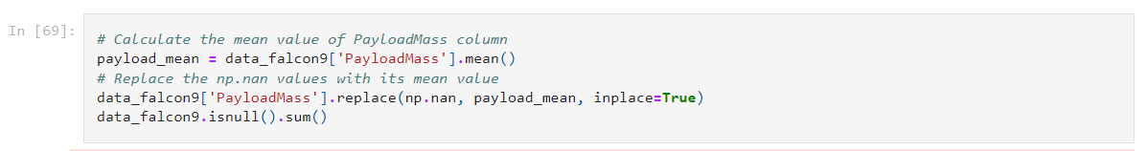
Appendix

Slide 54


